Slide 1
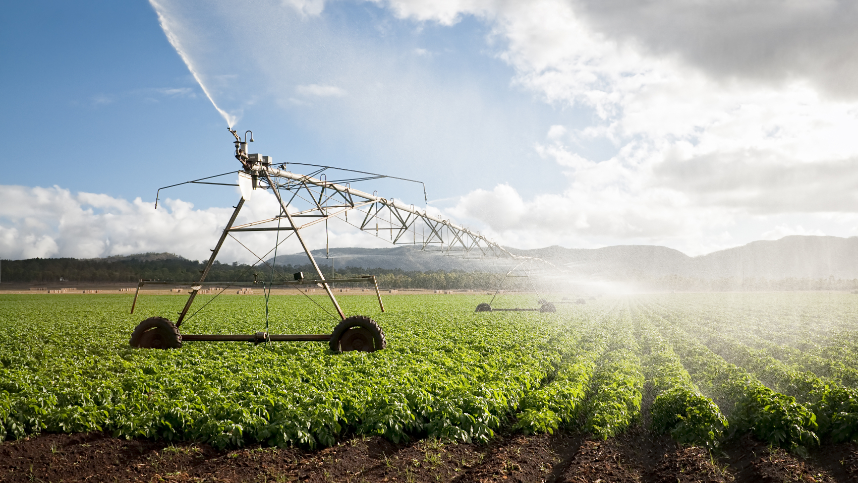
Genetic Programing Meets Agriculture
Brad Bazemore
Brent Lippert
Chandler Kincaid

Slide 2
Problem
Farmers need to know about the environment
Detect plant dieses
Prevent over/under watering
Prevent frost

Slide 3
Problem
Environmental sensors are expensive
Constant calibration
Some sensors are simple
Temperature/Humidity

Slide 4
Goal
Derive wet bulb from temperature and relative humidity

Slide 5
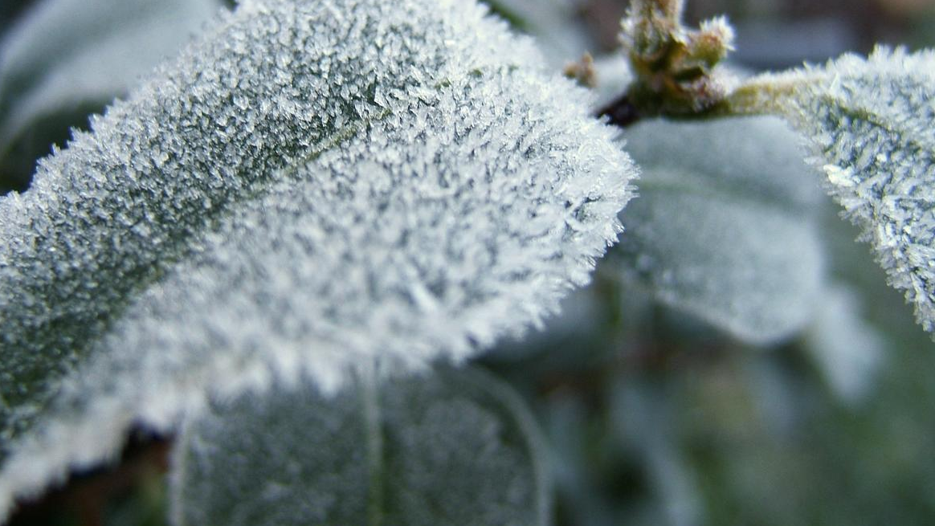
Background

Slide 6
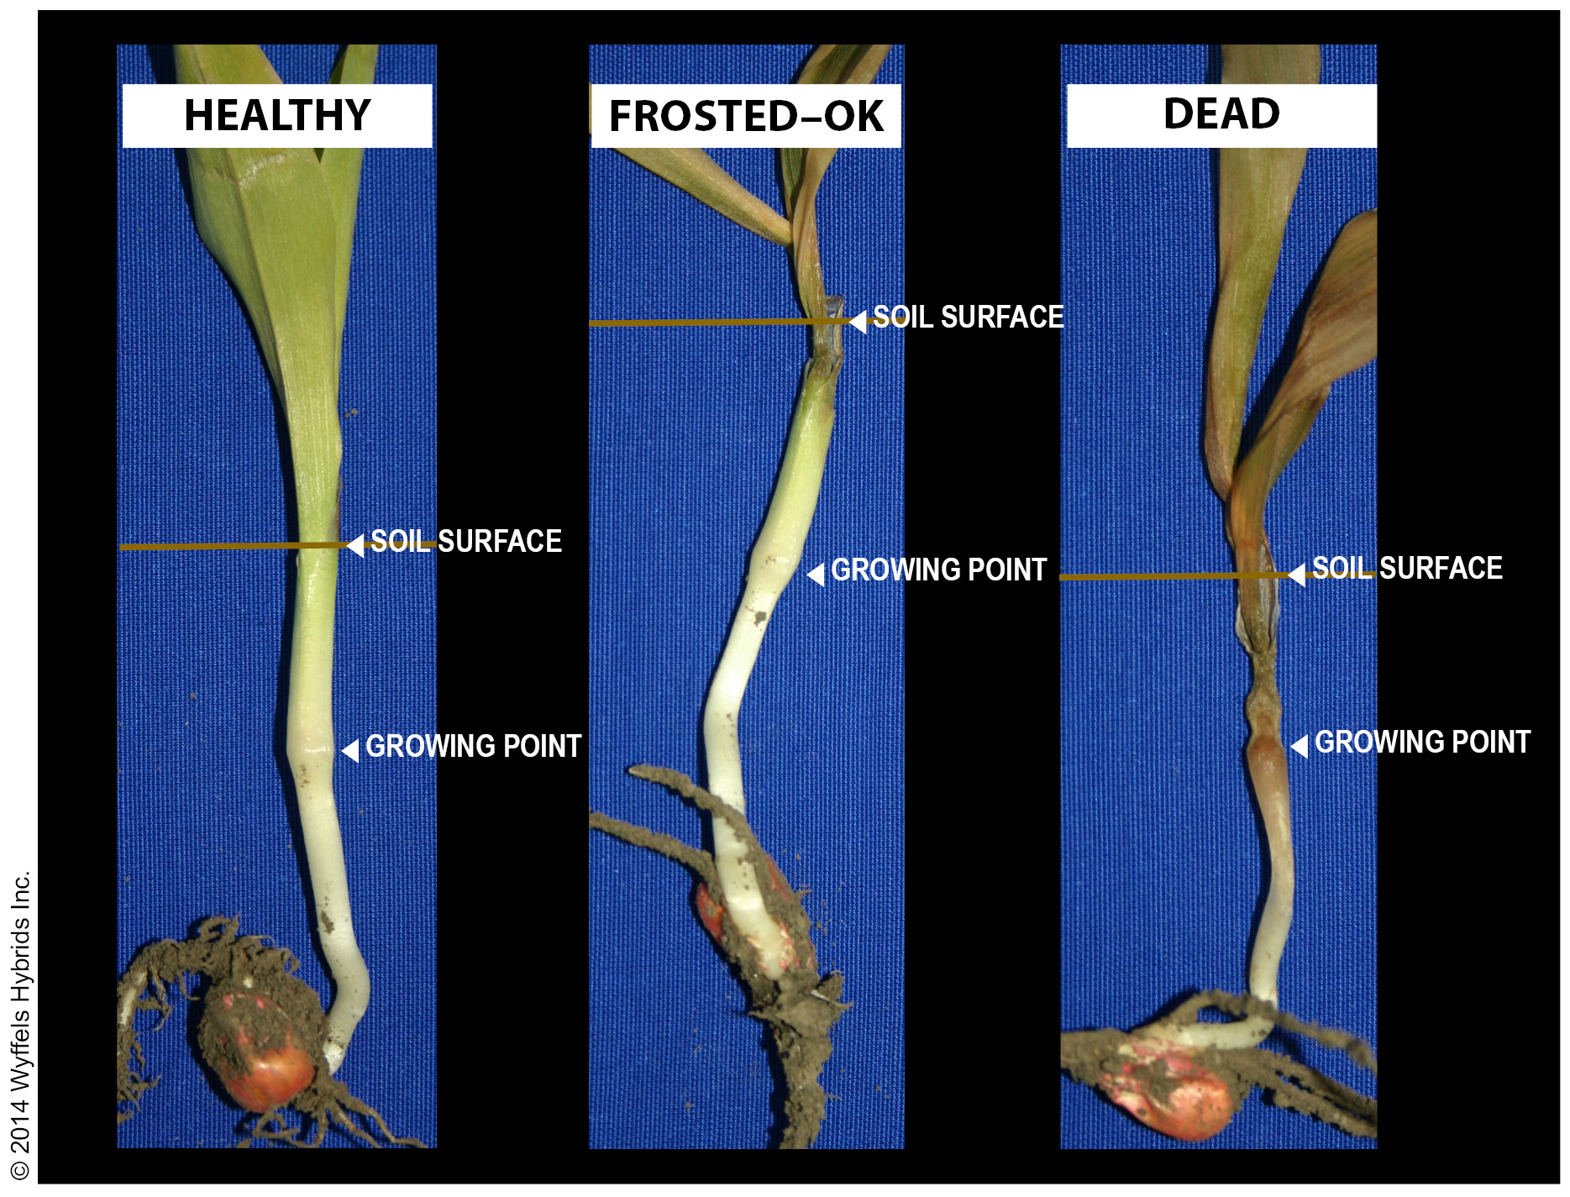
Freeze/Frost
Freeze: defined as the occurrence of air temperatures below 32oF or lower measured at five feet above the ground.
Frost: when the temperature of the earth's surface or objects on the earth's surface are 32oF or lower.

Slide 7
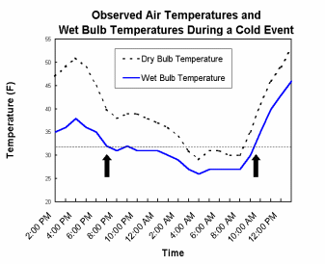
Wet bulb
“The wet bulb temperature is the temperature air cools to when water is added.”

Slide 8
What is it used for?
“Many growers use water to protect crops from freezing temperatures. It works because when water freezes on plants it releases small amounts of heat. This heat keeps plant temperatures at 32 F, even when air temperatures are colder.”

Slide 9

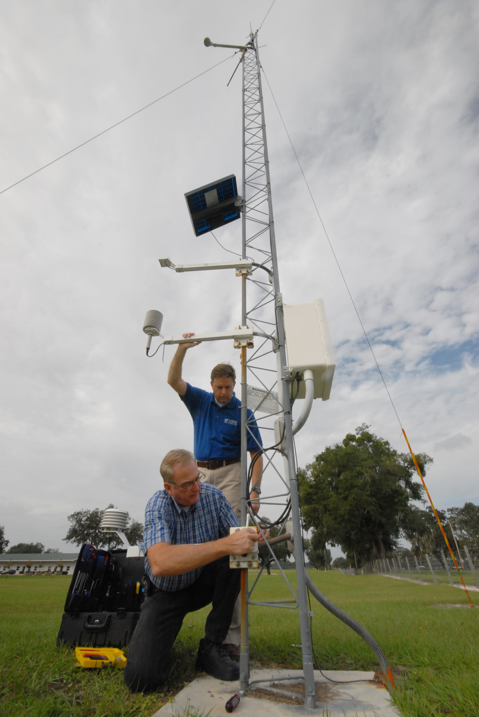
Data Source
Public network of weather stations in Florida
Ran by the University of Florida
44 stations covers all parts of the state
Has been operating since 1997
Collects data every 15 minutes.
All stations have the same set of sensors.

Slide 10
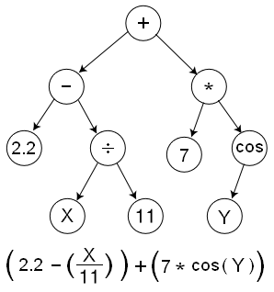
Genetic Programing
A way to evaluate the fitness of an individual
Selective pressure on the population of individuals based on said fitness
An intelligent way to make new individuals

Slide 11
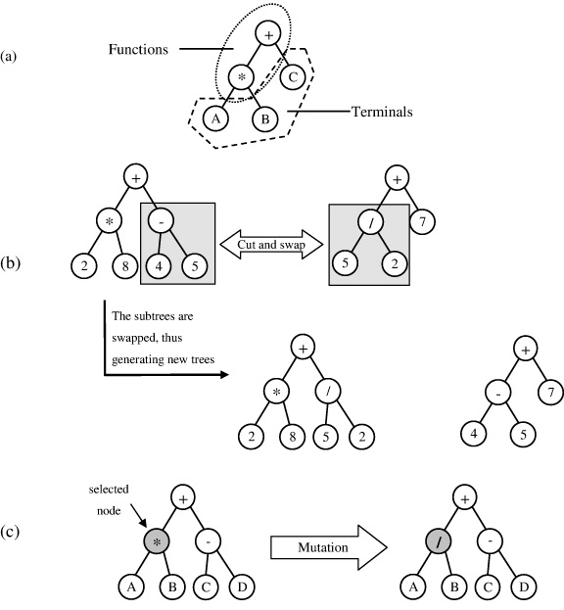
Genetic Programing

Slide 12
Prediction/Ground Truth
wet-bulb temperature as a function of air temperature and relative humidity
valid for relative humidity levels between 5% and 99%
air temperatures between -20C and 50C
Wet-Bulb Temperature from Relative Humidity and Air Temperature

Slide 13
Prediction/Ground Truth
es = Saturated Vapor Pressure
P = Station Pressure
T = Air Temperature (2m)
Two= Wet Bulb Temperature (from previous iteration, 0 in first iteration)
Td= Dew Point Temperature (2m)
Tw= es- 0.000666 * P * (T -Two) - Td

Slide 14
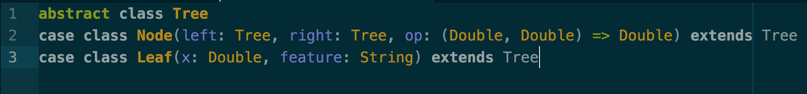
Data Structure

Slide 15
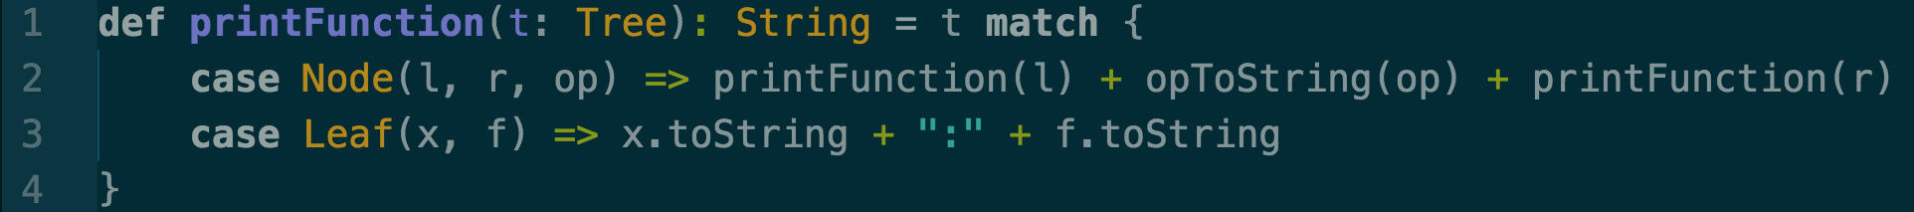
Recursive Functions

Slide 16
Preliminary Results
(2.0552293181588595:rh_2m_pct +
-0.009607710601272705:temp_dp_2m_C)
158.62156659812626

Slide 17
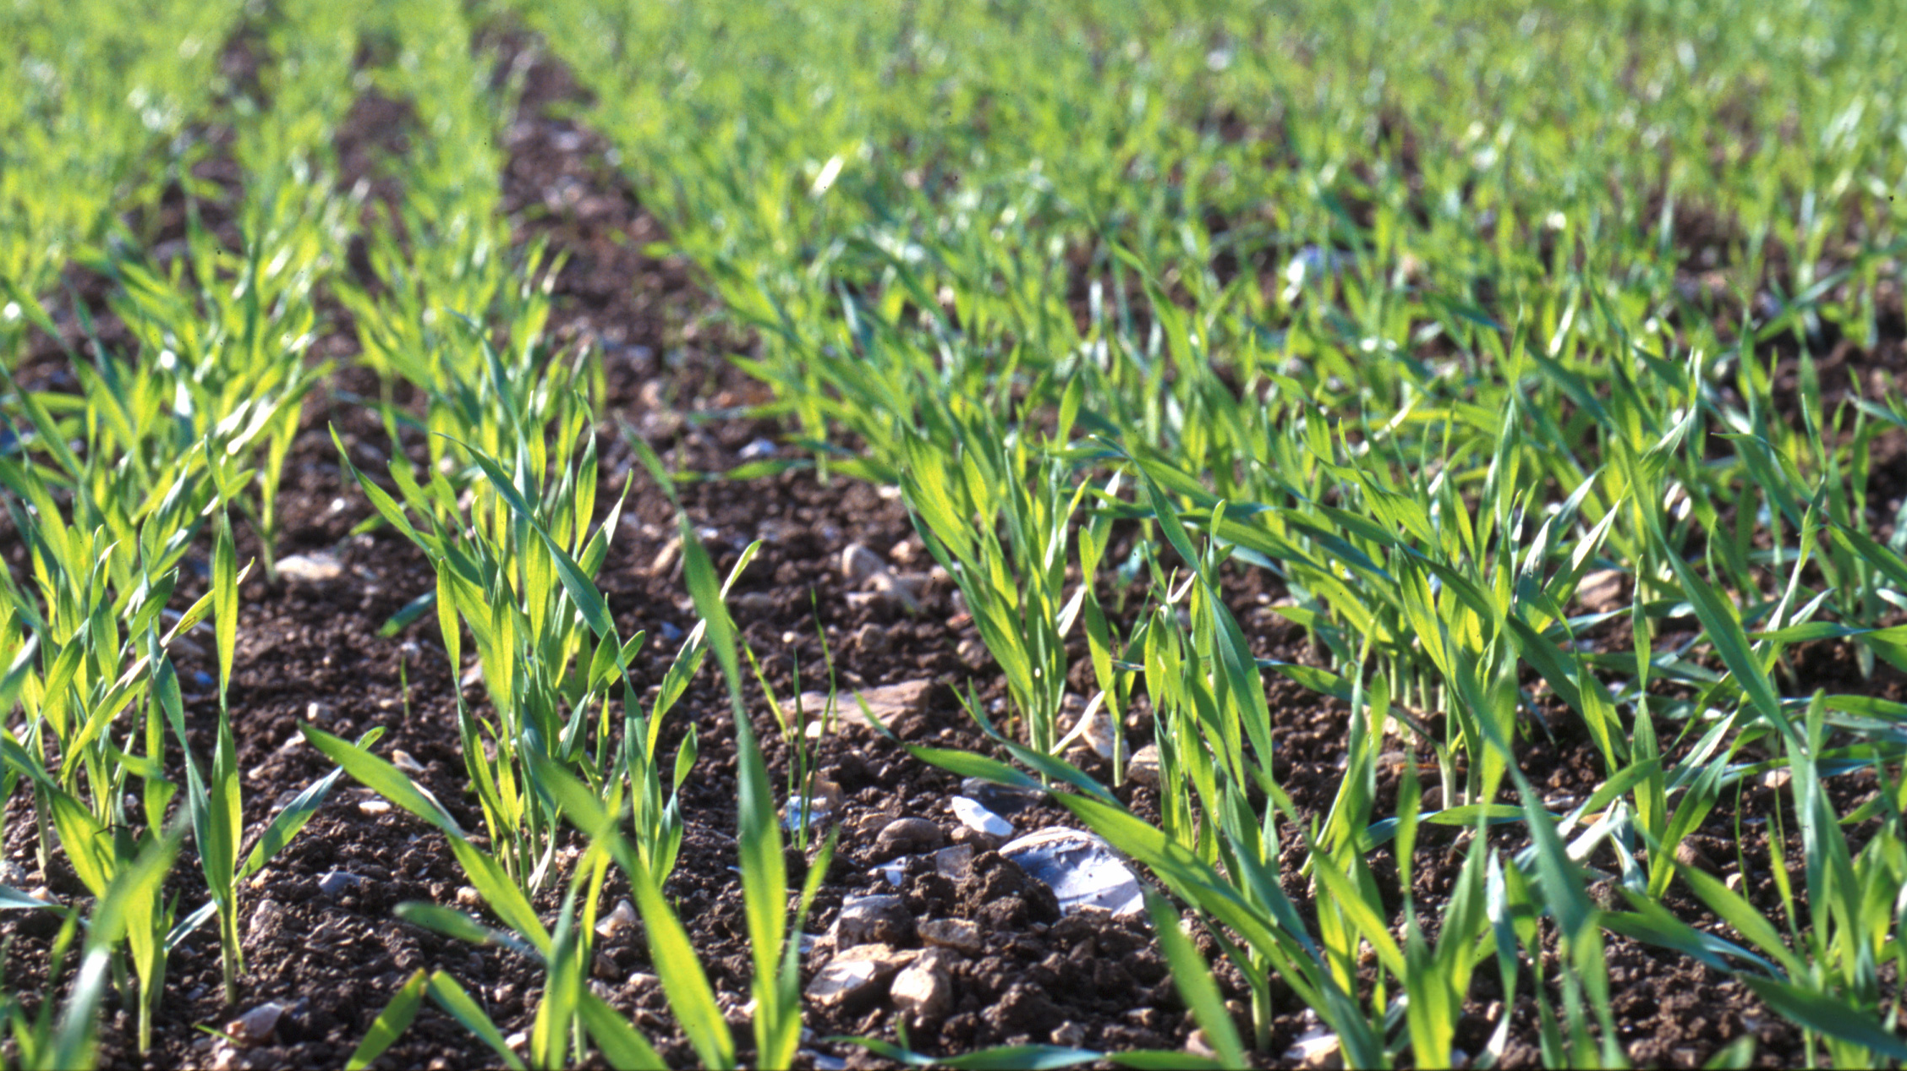
What we are doing next

Slide 18


Thank you

